Slide 1

3rd May, 2024

Slide 2

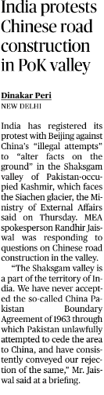
HEADLINES OF THE DAY
India has registered its protest with Beijing against China’s “illegal attempts” to “alter facts on the ground” in the Shaksgam valley of occupied Kashmir, which faces the Siachen glacier
The Shaksgam valley is part of Pakistan Occupied Kashmir, and was ceded by Pakistan to China in 1963, a year after the India-China war.
Do you know ?
The Siachen glacier, the world’s highest battlefield, is a piece of Indian territory wedged between China and Pakistan.
The 2020 standoff between Indian and Chinese troops in eastern Ladakh has made the control of Siachen even more critical for India. China has undertaken a massive build-up and deployment along the Line of Actual Control, especially in eastern Ladakh,
The Hindu-IR(GSII)-Page 1

Slide 3
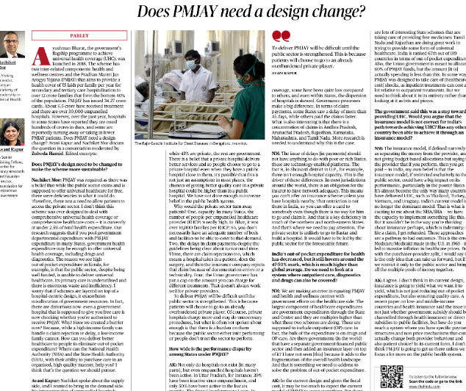
HEADLINES OF THE DAY
Ayushman Bharat, the government’s flagship programme to achieve universal health coverage (UHC), was launched in 2018. The scheme has two inter-related components: health and wellness centres and the Pradhan Mantri Jan Arogya Yojana (PMJAY) that aims to provide a health cover of ₹5 lakh per family per year for secondary and tertiary care hospitalisation to over 12 crore families that form the bottom 40% of the population.
PM-JAY has issued 34.27 crore cards. About 6.5 crore have received treatment and there are over 30,000 empanelled hospitals
The Hindu-Health(GSII)-Page 9

Slide 4
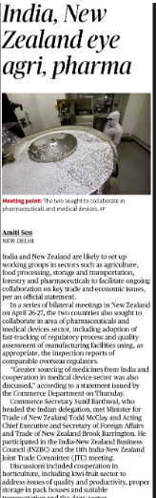
HEADLINES OF THE DAY
India and New Zealand concluded the 11th Joint Trade Committee (JTC) meeting in New Zealand.
The meeting highlighted the immense potential for collaboration between the two nations, particularly in sectors like pharmaceuticals, agriculture, and food processing. Both sides acknowledged the existing trade complementarities and expressed a commitment to enhancing bilateral trade and people-to-people contacts.
The Hindu-IR(GSII)

Slide 5
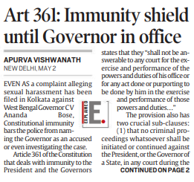
HEADLINES OF THE DAY
a complaint alleging sexual harassment has been filed in Kolkata against West Bengal Governor
, Constitutional immunity bars the police from naming the Governor as an accused or even investigating the case.
  Article 361 of the Constitution that deals with immunity to the President and the Governors states that they “shall not be answerable to any court for the exercise and performance of the powers and duties of his office or for any act done or purporting to be done by him in the exercise and performance of those powers and duties…”
Indian Express-Polity and Governance(GSII)-Page 1

Slide 6
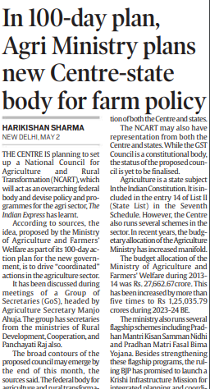
HEADLINES OF THE DAY
THE CENTRE IS planning to set up a National Council for Agriculture and Rural Transformation (NCART), which will act as an overarching federal body and devise policy and programmes for the agri sector
the idea, proposed by the Ministry of Agriculture and Farmers’ Welfare as part of its 100-day action plan for the new government, is to drive “coordinated” actions in the agriculture sector.
The NCART may also have representation from both the Centre and states. While the GST Council is a constitutional body, the status of the proposed council is yet to be finalised.
Do you know ?
Agriculture is a state subject In the Indian Constitution. It is included in the entry 14 of List II (State List) in the Seventh Schedule. However, the Centre also runs several schemes in the sector. In recent years, the budgetary allocation of the Agriculture Ministry has increased manifold.
Indian Express-Agriculture (GSIII)-Page 8

Slide 7
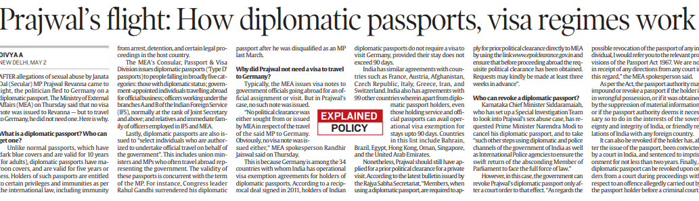
HEADLINES OF THE DAY
Unlike normal passports, which have dark blue covers and are valid for 10 years (for adults), diplomatic passports have ma- roon covers, and are valid for five years or less. Holders of such passports are entitled to certain privileges and immunities as per the international law, including immunity from arrest, detention, and certain legal pro- ceedings in the host country.
The MEA's Consular, Passport & Visa Division issues diplomatic passports (Type D passports) to people falling in broadly five cat- egories: those with diplomatic status; gover- ment-appointed individuals travelling abroad for official business; officers working under the branches Aand B of the Indian Foreign Service (IPS), normally at the rank of Joint Secretary and above; and relatives and immediate family of officers employed in IFS and MEA.
Lastly, diplomatic passports are also issued to "select individuals who are author ized to undertake official travel on behalf of the government". This includes union ministers and MPs who often travel abroad rep- resenting the government. The validity of these passports is concurrent with the term of the MP.
Indian Express-Miscellaneous

Slide 8

HEADLINES OF THE DAY
Mpox (monkeypox) is a viral illness caused by the monkeypox virus, a species of the genus Orthopoxvirus.
Mpox can be transmitted to humans through physical contact with someone who is infectious, with contaminated materials, or with infected animals.
Mpox can be prevented by avoiding physical contact with someone who has mpox. Vaccination can help prevent infection for people at risk.
Indian Express-Health(GSII)-Page 13

Slide 9
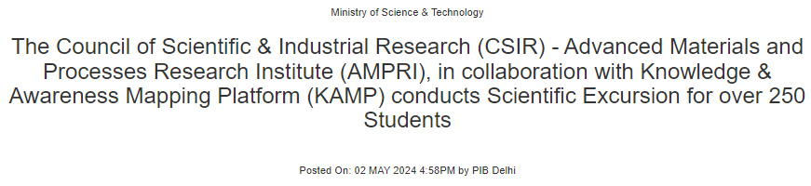
HEADLINES OF THE DAY
The Council of Scientific and Industrial Research (CSIR) - Advanced Materials and Processes Research Institute (AMPRI), in collaboration with the Knowledge and Awareness Mapping Platform (KAMP), conducts Scientific Excursion on April 29th, 2024 at Bhopal, Madhya Pradesh.
The Scientific Excursion was conducted by KAMP under the CSIR Jigyasa and Viksit Bharat Program with 250 students accompanied by their teachers
The Knowledge and Awareness Mapping Platform (KAMP), an initiative and knowledge alliance between the Council of Scientific & Industrial Research (CSIR) - National Institute of Science Communication and Policy Research (NIScPR) and industrial partner M/S Nysa Communications Pvt. Ltd. (NCPL) provides a platform for students to explore and engage with scientific concepts, develop a holistic understanding, and ignite their scientific curiosity.
Pib-S&T(GSIII)

